Slide 1
Quadratics

Slide 2
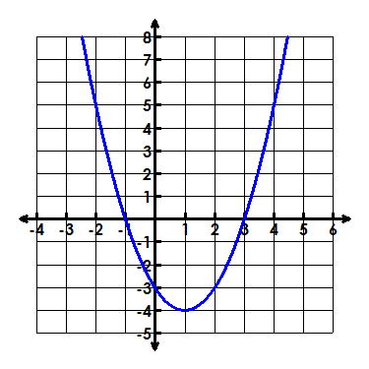
Characteristics
Domain:
Range:

Slide 3
Characteristics
Zeros:
Y-intercept:

Slide 4
Characteristics
Extreme Value:

Slide 5
Characteristics
Interval of Increase:
Interval of Decrease:

Slide 6
Characteristics
Axis of Symmetry:
Vertex:

Slide 7
Characteristics
Rate of change from -2 ≤ x ≤ 0

